Slide 1
Multilingual Translation – (1)
Traditionally,
If a parallel corpus exists, one system for each language pair.
Parallel corpus:
Translation system:
If no direct parallel corpus exists, a pivot-based translation.
No direct parallel corpus:
But,
Then,
c is a pivot language (often, English.)
No knowledge transfer between different language pairs.

Slide 2
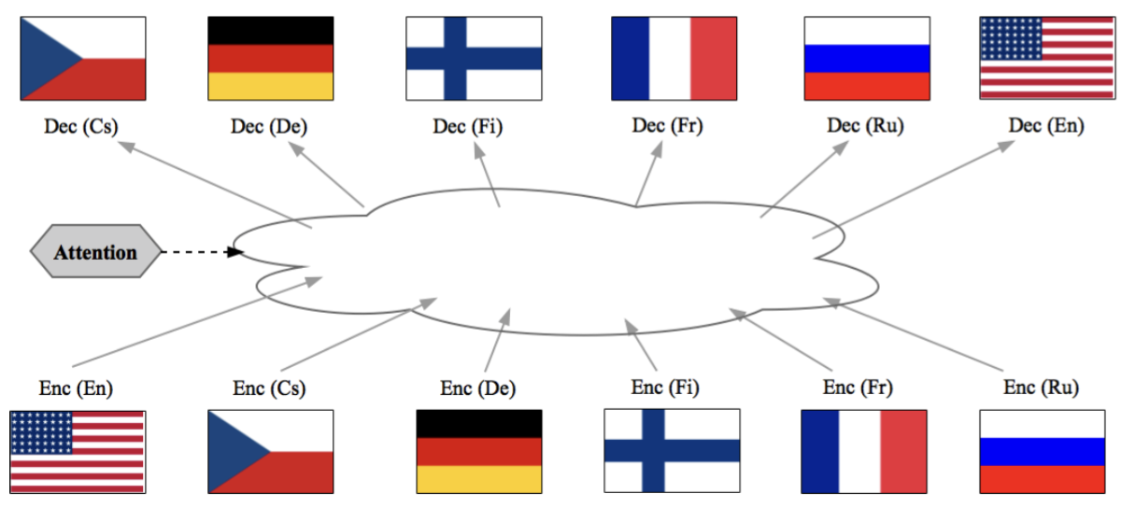
Multilingual Translation as Multitask Learning – (2)
Now, [Firat et al., 2016a; Firat et al., 2016b; Johnson et al., 2016; Ha et al., 2016; Lee et al., 2017]

Slide 3
Multilingual Translation as Multitask Learning – (3)
Separate encoder/decoders
[Firat et al., 2016a; Firat et al., 2016b]
One encoder per source l
One decoder per target l’
For each pair (l, l’),
Universal encoder/decoders
[Johnson et al., 2016; Ha et al., 2016; Lee et al., 2017; Gu et al., 2018]
Shared lexicons
A shared vocabulary of language-agnostic tokens [J, 2016; H, 2016; L, 2017]
Universal lexical representation [G, 2018]
One encoder-decoder for all pairs
Train using all available language pairs

Slide 4
Multilingual Translation as Multitask Learning – (4)
Does it work?
Single-pair Systems De→En, Cs→En, Fi→En, Ru→En
Multilingual System {De, Cs, Fi, Ru}→En
The latter has 1/4x parameters
Better translation quality on low-resource languages (Fi & Ru)
Lee, Cho and Hoffman (2017)

Slide 5
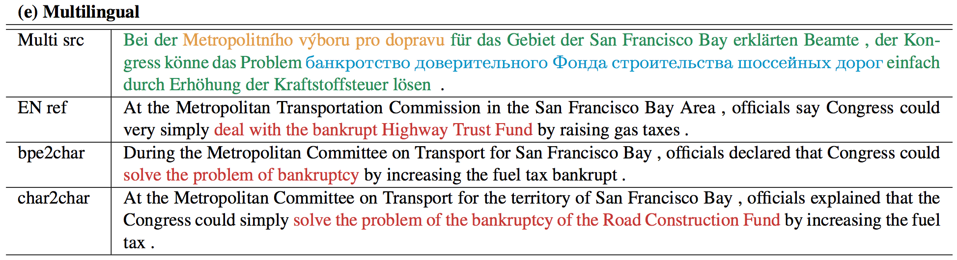
Multilingual Translation as Multitask Learning – (5)
Does it work? – Yes!*
Single-pair Systems vs. Multilingual System
Works with intra-sentence code-switching
* It often fails to translate between a pair of languages not seen during training
Lee, Cho and Hoffman (2017)

Slide 6
Limitations of Multitask Learning – (1)
Tricky when the availability of data drastically differs across languages.
overfitting on low-resource pairs, while underfitting on high-resource pairs.
Extremely low-resource pairs can easily be ignored.
See [Firat et al., 2016a] and [Lee et al., 2017] for more discussion.
It is really horrible to figure out how to tackle this in practice…

Slide 7
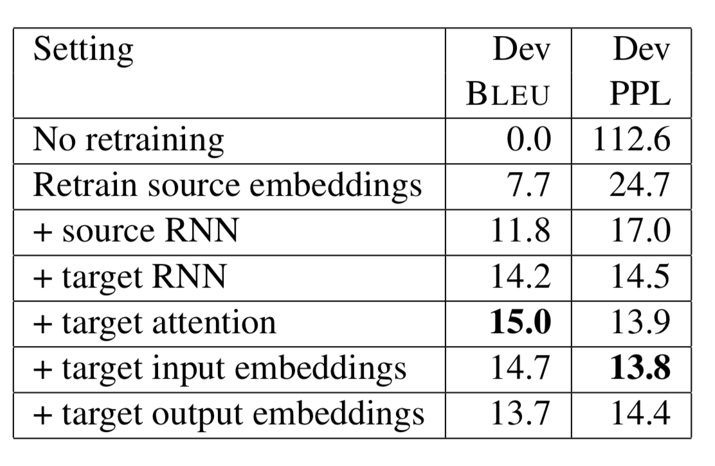
Limitations of Multitask Learning – (2)
Assumes the availability of all language pairs in advance.
The entire model must be re-trained each time a new language is introduced.
Transfer Learning [Zoph et al., 2016; Nguyen & Chiang, 2017]
Only re-train a subset of parameters on a new language pair.
Many possible strategies, but no clear winning strategy.
Zoph et al., 2016

Slide 8
Limitation of Multitask Learning – (3)
Inconvenient truths about multitask+transfer learning
Relies on our intuition that all languages/tasks share common underlying structures: true?
Assumes multitask learning can capture those underlying structures and share across multiple languages/tasks: true?
Assumes multitask-learned parameters are a good initialization for further training: true?
Is there a more satisfying approach?

Slide 9
Meta-Learning: MAML [Finn et al., 2018] – (1)
Model-agnostic meta-learning [Finn et al., 2018]
Two-stage learning
Simulated learning
Meta-learning

Slide 10
Meta-Learning: MAML [Finn et al., 2018] – (2)
Simulated learning
Given a small subset of the training set of task , update the model parameters times.
Clip the update so that does not deviate too much from .
It simulates finetuning on a target task with a limited resource.

Slide 11
Meta-Learning: MAML [Finn et al., 2018] – (3)
Meta-Learning
Randomly select a task and select a training subset .
Randomly select a validation subset for evaluation.
Update the meta-parameter by gradient descent: where
Update the meta-parameter so that -step GD on the -th task works well.

Slide 12
Meta-Learning: MAML [Finn et al., 2018] – (4)
Fast adaptation to a new task
Given a small training set of the new target task, SGD starting from the meta-parameter .
Early stopping based on .

Slide 13
Multitask learning vs. Meta-learning
Transfer learning does not take into account subsequent learning.
Multilingual learning does not take into account new, future tasks.
Meta-learning considers subsequent learning on new, future tasks.

Slide 14
Extension to Neural Machine Translation
I/O mismatch between different tasks
Vocabulary mismatch among different languages
Multilingual word embedding [Artetxe et al., 2017; Conneau et al., 2018; and more]
Project each token into a continuous vector space
Ensure that they are compatible:
Universal lexical representation [Gu et al., 2018]
Meta-NMT!

Slide 15
Experiments
Source tasks: all the languages from Europarl + Russian
Bg→En, Cs→En, Da→En, De→En, El→En, Es→En, Et→En, Fr→En, Hu→En, It→En, Lt→En, Nl→En, Pl→En, Pt→En, Sk→En, Sl→En, Sv→En and Ru→En.
Reasonable high-resource language pairs.
Target tasks: (simulated) low-resource language pairs
Ro→En, Lv→En, Fi→En, Tr→En and Ko→En
Approximately 16k target tokens (English side): roughly 800 sentence pairs.
Universal lexical representation: obtained from Wikipedia.
Early stopping of meta-learning: either Ro-En or Lv-En

Slide 16
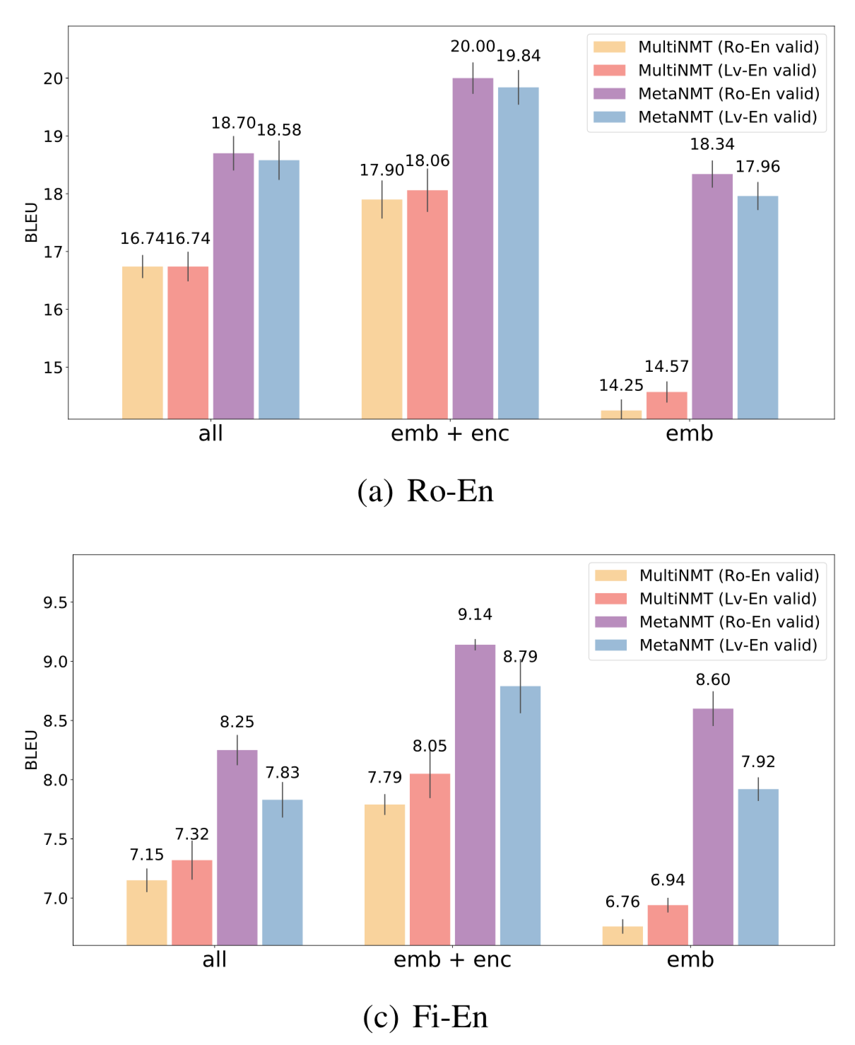
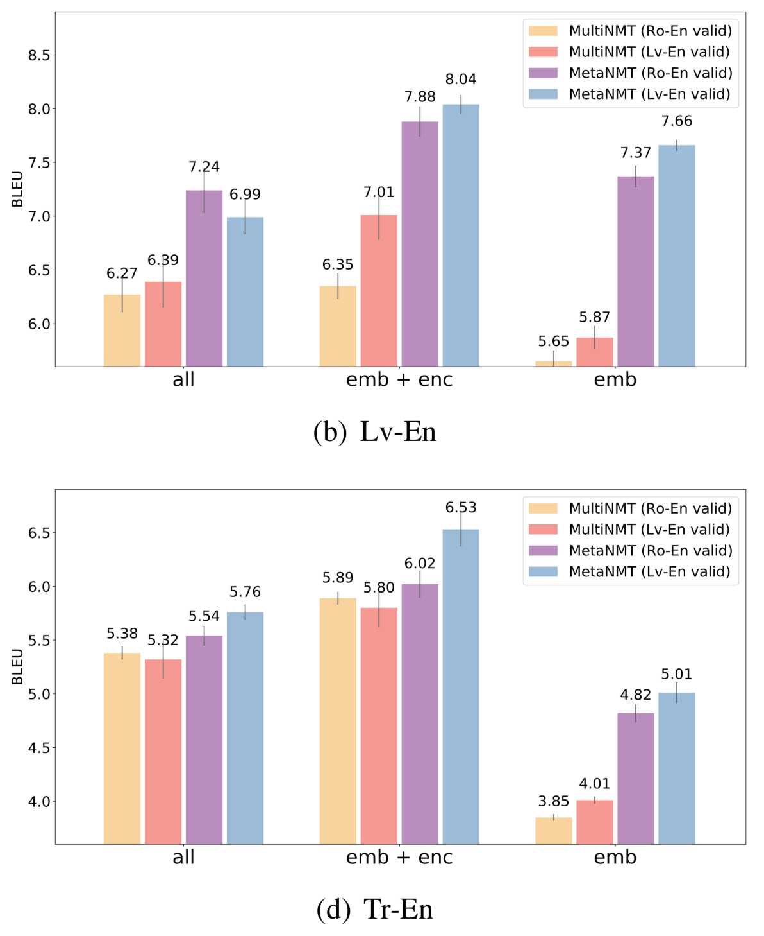

Slide 17
Experiments – (1)
Meta-learning outperforms multitask learning across all the target languages and across different finetuning strategies.
Using only 800 examples, reaches up to 65% of fully-supervised models in terms of BLEU.

Slide 18
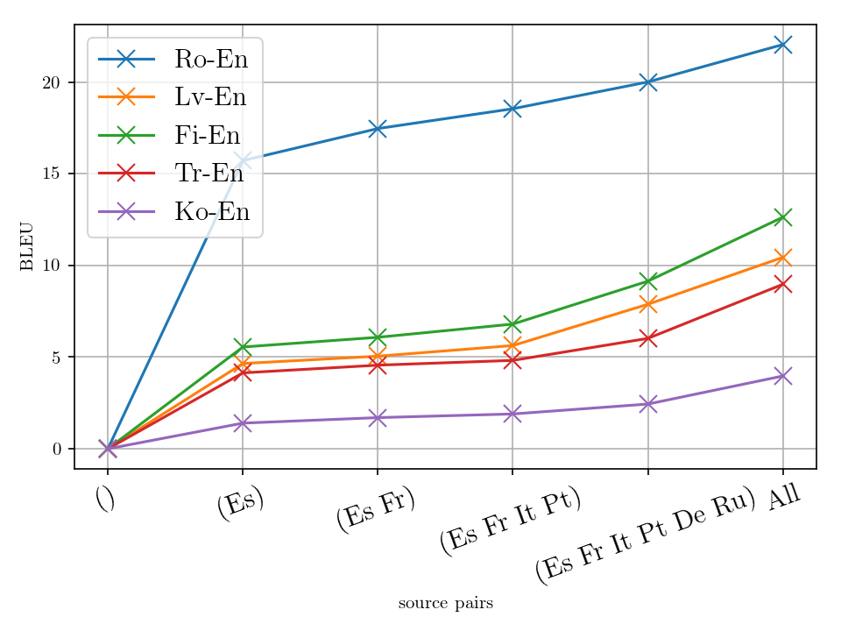
Experiments – (2)
More source tasks lead to greater improvements.
The similarity between source and target asks matters.

Slide 19
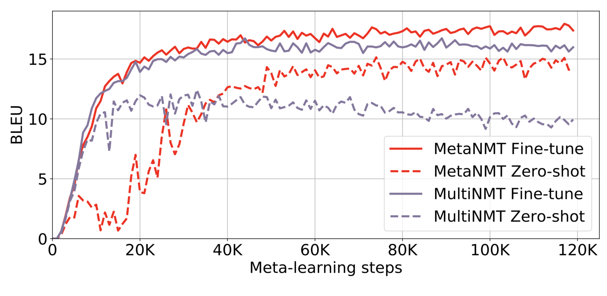
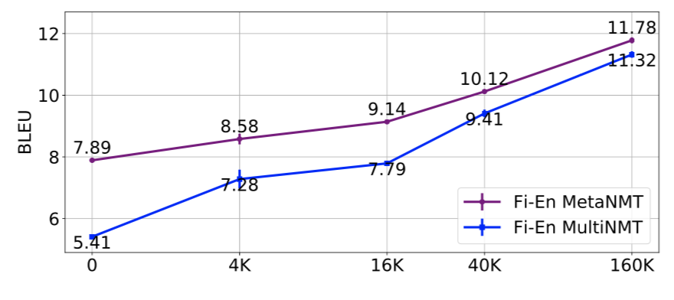
Experiments – (3)
Multi-task learning over-adapts to the source tasks.
Performance on the target task degrades with longer multi-task learning.
Meta-learning does not over-adapt.
The meta-learning objective explicitly takes into account finetuning on a target task.
It requires less target examples.
# of target examples

Slide 20
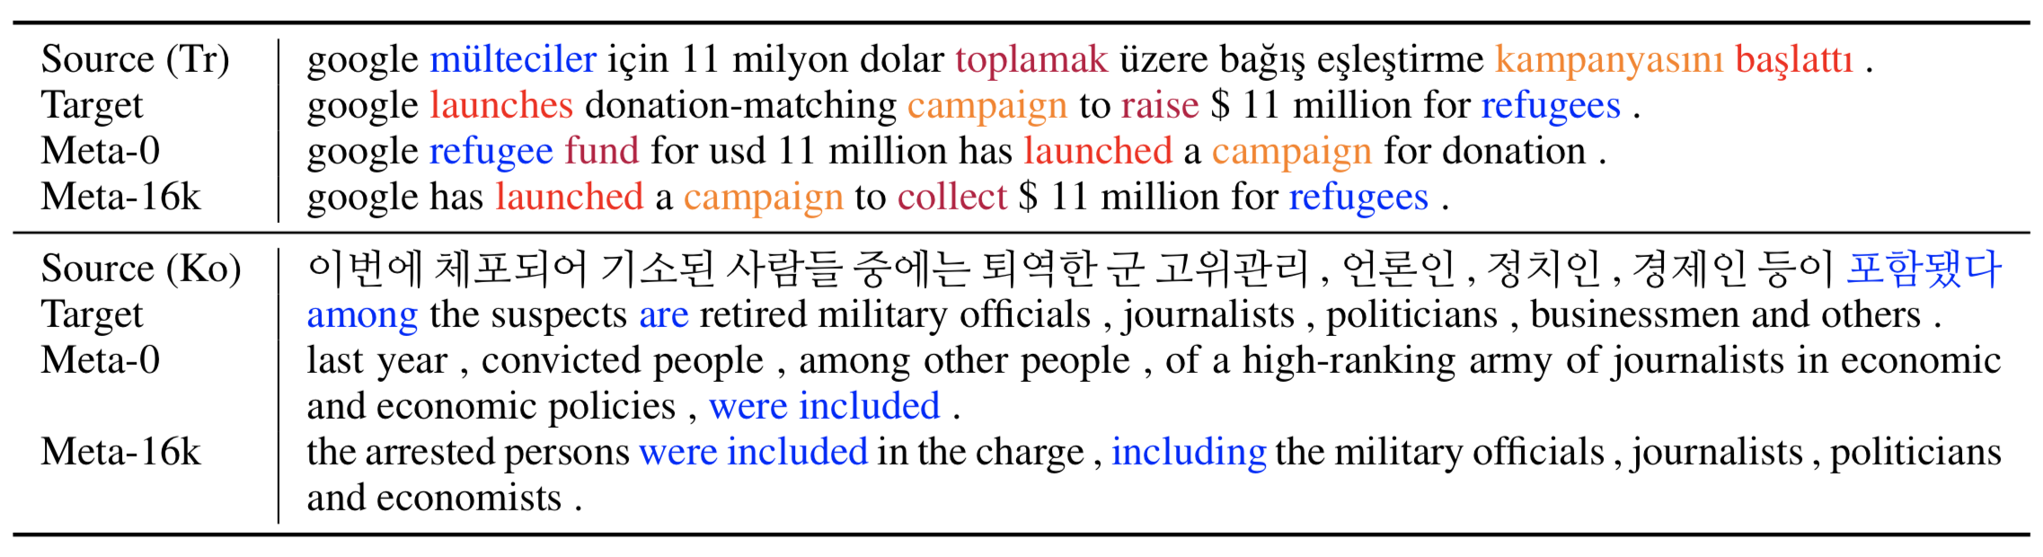
Experiments – (4) Sample Translations

Slide 21
Conclusion
Meta-learning allows us to exploit many high-resource tasks for extremely low-resource target tasks.
Gradual shift toward higher-order learning
Learning to optimize [Andrychowicz et al., 2017; and others]
Multi-agent modelling (theory of mind) [Foerster et al., 2018 LOLA; and others]
Neural architecture search [Zoph & Le, 2016; and others]
Hyperparameter search [Luketina et al., 2016; and others]
And more on the horizon…

